Slide 1

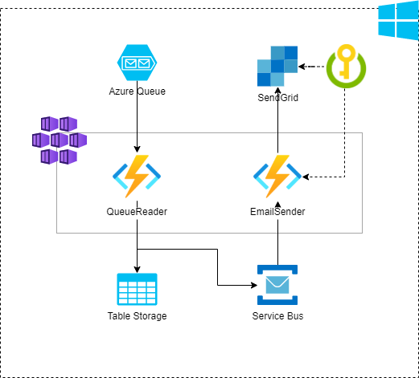

Architecture Sample

Slide 2
